Slide 1
Nuts and Bolts of Linux Socket Programming
Chun-Han Lin

Slide 2
Outline
Mail Analogy
HTTP Example
IP address
Port
Communication Protocol
Socket
Echo Server and Client

Slide 3


Mail Analogy
Protocol
Destination
Port
媽！！我沒錢了，
快匯錢給我！！！！
Destination
IP Address
台北市○○區○○路○○號
黃 ○ ○ 女士 收
Source
Port
林○○
新竹市大學路1001號工程三館622室
Source
IP Address

Slide 4
HTTP Example
Protocol
Destination
Port
GET /index.html
Destination
IP Address
www.nctu.edu.tw
140.113.60.211
80
Source
Port
55481
140.113.210.234
Source
IP Address

Slide 5
IP Address
An IP address is a numerical label assigned to each device participating in a computer network
Host identification
Location addressing
IP addresses are binary numbers
IPv4 : 32-bit
74.125.31.103
IPv6 : 128-bit
2404:6800:4008:c01::93

Slide 6
Port
A port is an application-specific software construct serving as a communications endpoints in a computer’s host operating system
A port number is a 16-bit number
20 : FTP data transfer
21 : FTP control
23 : Telnet
53 : Domain Name System
80 : HTTP
etc…

Slide 7
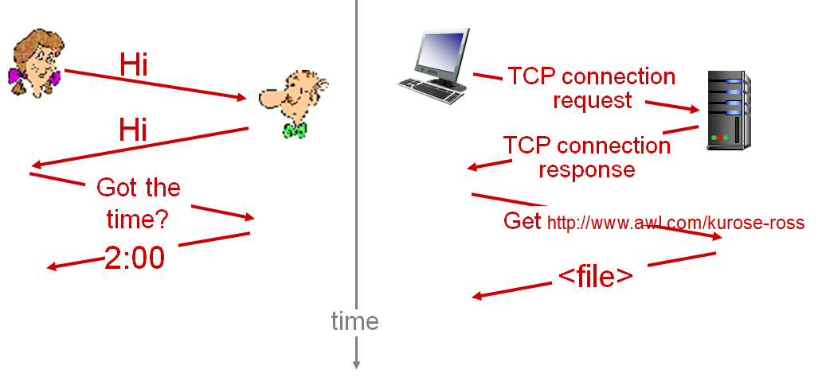
Communication Protocol
A communication protocol is a system of digital rules for message exchange between computers

Slide 8
Socket
Network socket
An endpoint of an inter-process communication flow across a computer network
Socket API
Allows application programs to control and use network sockets
By using socket API, programmers can focus on the design of their application instead of how to transfer data over the network

Slide 9
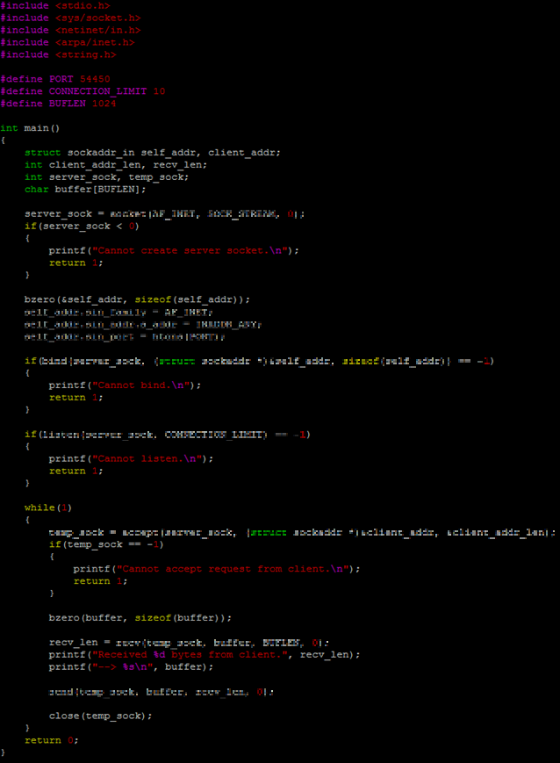
Echo Server - Overview
Create socket
Initialize
sockaddr
bind
listen
accept
recv
send

Slide 10

Echo Server – Create Socket
int socket(int domain, int type, int protocol)
In sys/socket.h
Arguments
Domain
AF_INET : The IPv4 address family
Type
SOCK_STREAM : TCP
Protocol
0 : Auto
Return
Success : The socket ID
Fail : -1

Slide 11

Echo Server – Initialize sockaddr
Structure member
sin_family
AF_INET : The IPv4 address family
sin_addr.s_addr
INADDR_ANY : All interfaces
sin_port
Port number
htons
Convert a short from host to TCP/IP network byte order
In netinet/in.h

Slide 12

Echo Server - bind
Associates a socket with a local endpoint
int bind(int socketfd, struct sockaddr * addr, size_t addr_len)
In sys/socket.h
Arguments
socketfd : The socket
addr : A pointer which points to the sockaddr_in
addr_len : The length of sockaddr_in
Return
Success : 0
Fail : -1

Slide 13

Echo Server - listen
Set the socket to listening socket, and inform the OS that the socket is ready for accepting incoming connections
int listen(int socketfd, int backlog)
In sys/socket.h
Arguments
socketfd : The socket
backlog : The maximum rate at which the server can accept new TCP connections
Return
Success : 0
Fail : -1

Slide 14

Echo Server - accept
Accept the request of the incoming connection
int accept(int socketfd, struct sockaddr * addr, size_t addrlen)
In sys/socket.h
Arguments
socketfd : The socket
addr : A pointer points to the sockaddr_in which stores the IP address of the client
addrlen : The length of sockaddr_in
Return
Success : The socket ID of the client
Fail : -1

Slide 15

Echo Server - recv
Receive data from socket
int recv(int socket, void *buf, int len, unsigned int flag)
In sys/socket.h
Arguments
socket : The socket
buf : A pointer which points to the buffer for the incoming data
len : The maximum length of receiving data
flag : 0
Return
Success : The length of received data
Fail : -1

Slide 16
Echo Server - send
Send data through socket
int send(int socket, void *msg, int len, unsigned int flags)
In sys/socket.h
Arguments
socket : the socket
msg : A pointer which points to the buffer
len : The maximum length of outgoing data
flags : 0
Return
Success : The length of transmitted data
Fail : -1

Slide 17
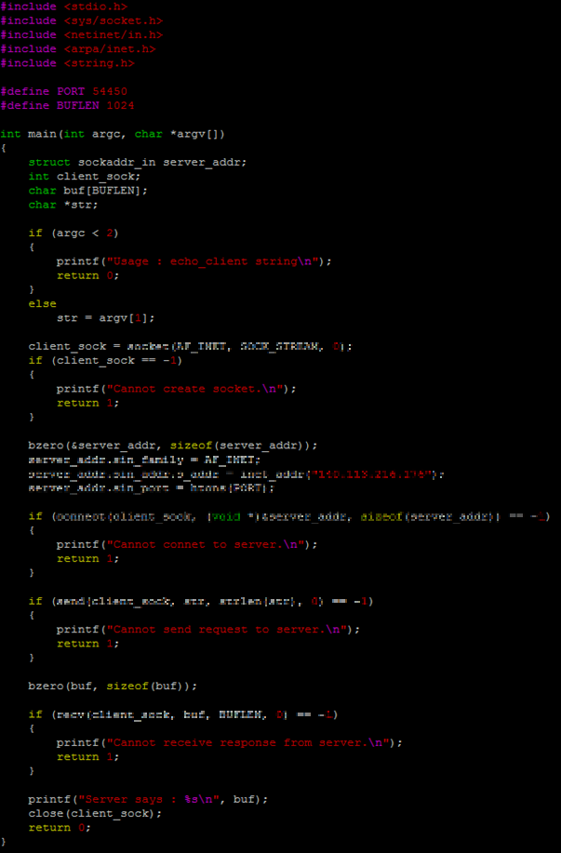
Echo Client - Overview
Create socket
Initialize
sockaddr
connect
send
recv

Slide 18

Echo Client – Initialize sockaddr
Structure member
sin_family
AF_INET : The IPv4 address family
sin_addr.s_addr
IP address of the server
inet_addr
Convert string of IP address to 32-bit unsigned integer
In netinet/in.h, arpa/inet.h
sin_port
Port number
htons
Convert a short from host to TCP/IP network byte order
In netinet/in.h

Slide 19

Echo Client - connect
Establish connection between client and server
int connect(int sockfd, struct sockaddr *addr, int addrlen)
In sys/socket.h
Arguments
sockfd : The socket
addr : A pointer points to the sockaddr_in which stores the IP address and port number of the server
addrlen : The length of sockaddr_in
Return
Success : 0
Fail : -1

Slide 20
Q & A

